Slide 1
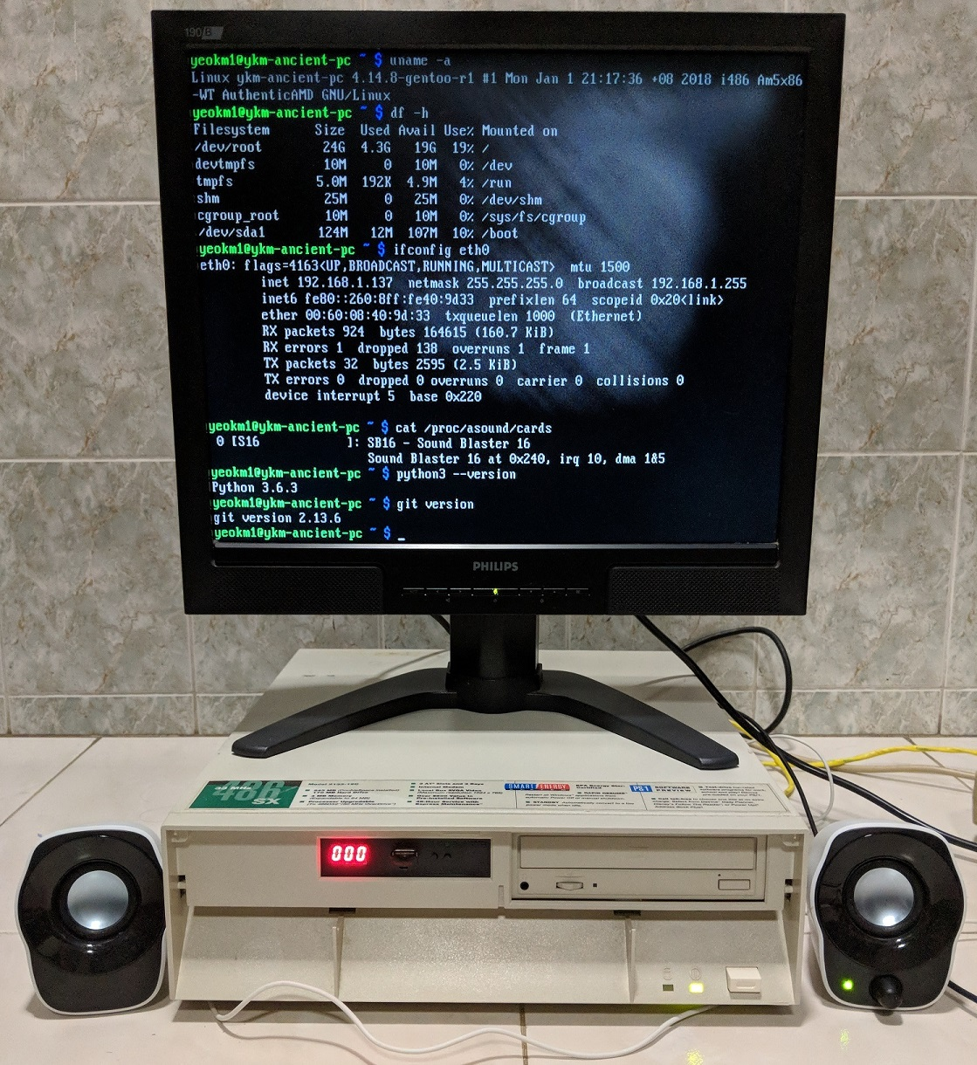
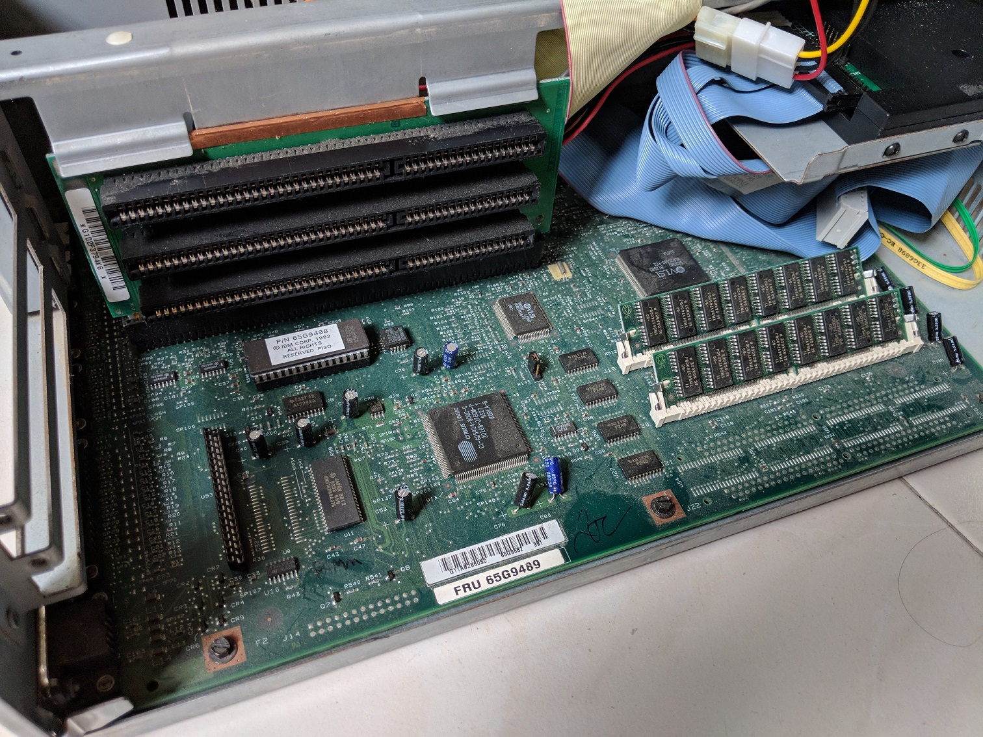
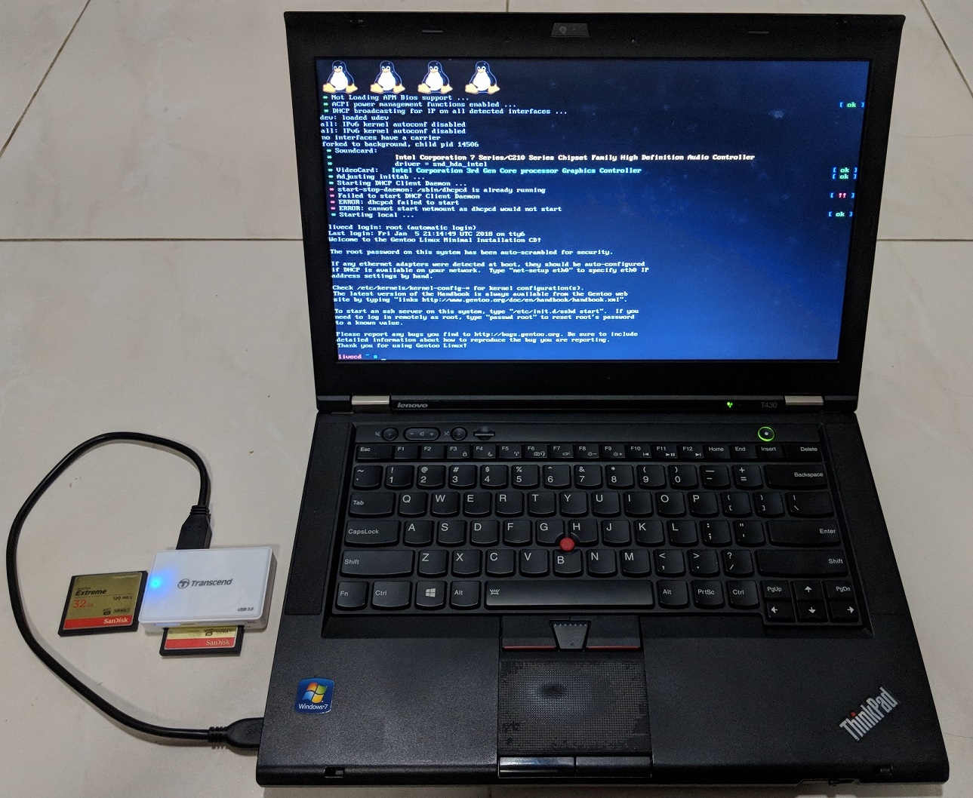
Modern Linux on a 486 PC
By: Yeo Kheng Meng (yeokm1@gmail.com)
http://yeokhengmeng.com/2018/01/make-the-486-great-again/
https://github.com/yeokm1/gentoo-on-486/
SP Digital Tech Talk (22 Feb 2018)
Hackware v3.8 (6 Feb 2018)

Slide 2
What is the oldest x86 processor that is still supported by a modern Linux kernel?

Slide 3
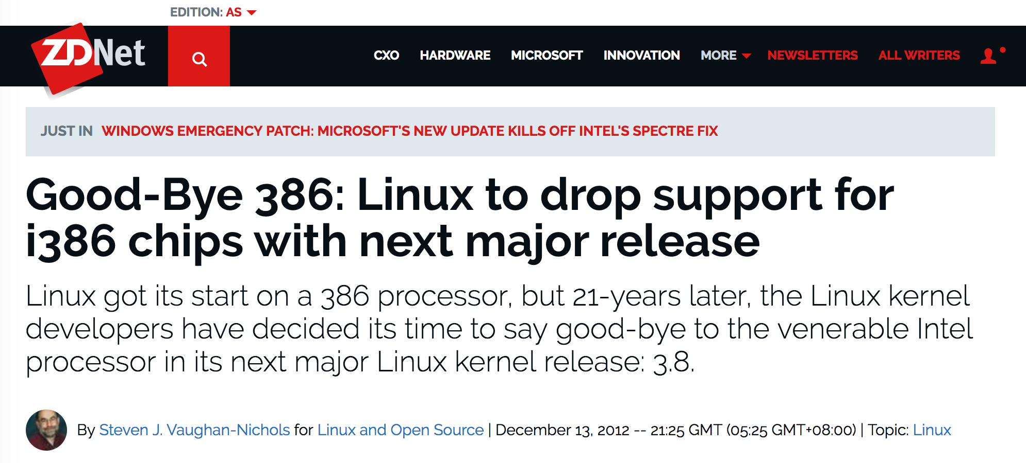
http://www.zdnet.com/article/good-bye-386-linux-to-drop-support-for-i386-chips-with-next-major-release/
(13 Dec 2012)

Slide 4
What is a 386 or 486?

Slide 5
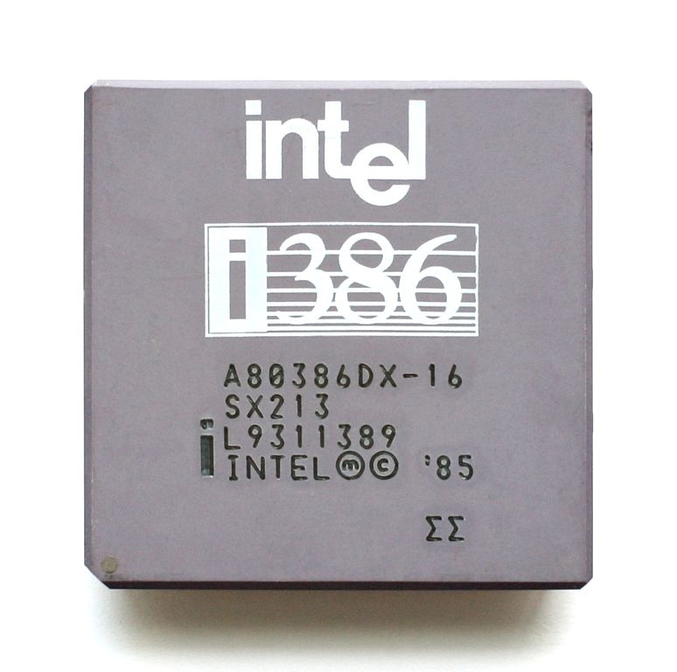
The 386
Released in 1985
First 32-bit CPU by Intel
12 Mhz to 40 Mhz

Slide 6
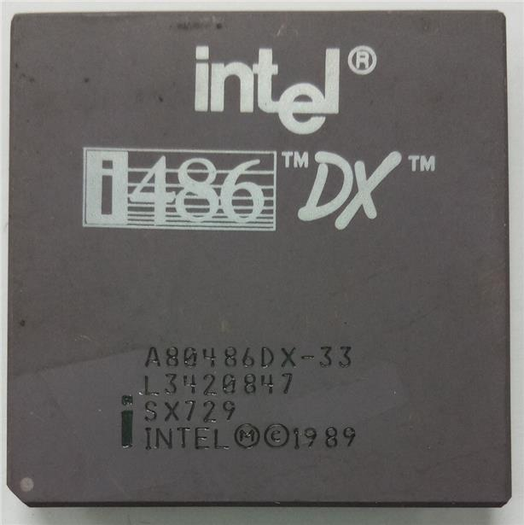
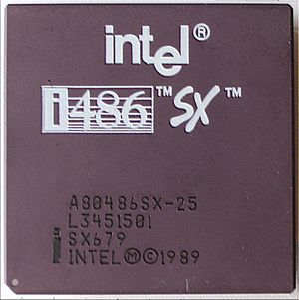
The 486
Released in 1989
First to have 8KiB onboard L1 cache
Variants
486DX: With Floating Point Unit (FPU)
486SX: Without FPU
16 MHz to 100 MHz

Slide 7
First Linux announcement
Hello everybody out there using minix –
I’m doing a (free) operating system (just a hobby, won’t be big and professional like gnu) for 386(486) AT clones.
…
PS. Yes – it’s free of any minix code, and it has a multi-threaded fs. It is NOT portable (uses 386 task switching etc), and it probably never will support anything other than AT-harddisks, as that’s all I have :-(.
Linus (torvalds@kruuna.helsinki.fi)
Organization: University of Helsinki
25 Aug 91 20:57:08 GMT
http://www.thelinuxdaily.com/2010/04/the-first-linux-announcement-from-linus-torvalds/

Slide 8
Prior Work

Slide 9

“Come together with fellow developers, engineers and designers to build cool projects with absolutely no value whatsoever. Yes, the more boliao the better.”
(9 December 2017)

Slide 10
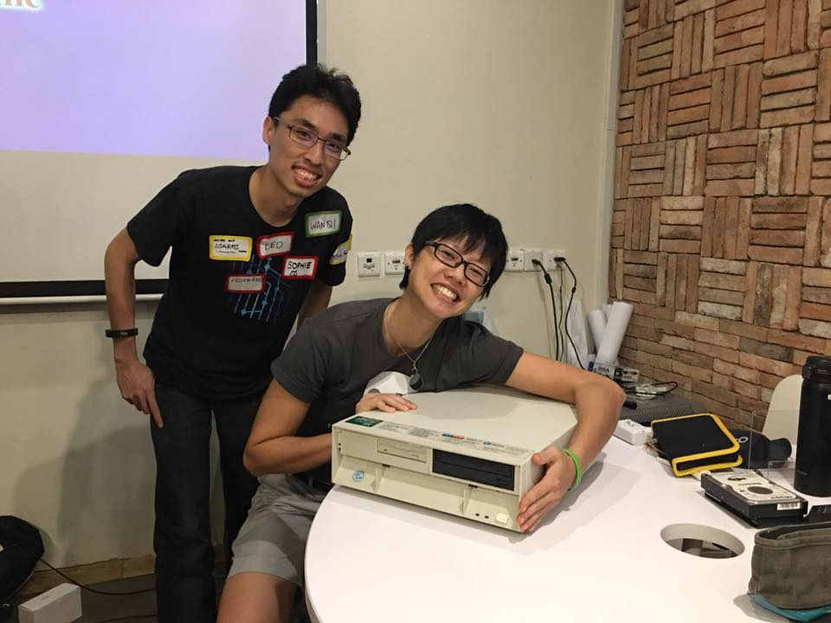
Team 486 at Super Silly Hackathon
Huijing and I
Damn Small Linux + Web Page Hosting + Playing Music

Slide 11
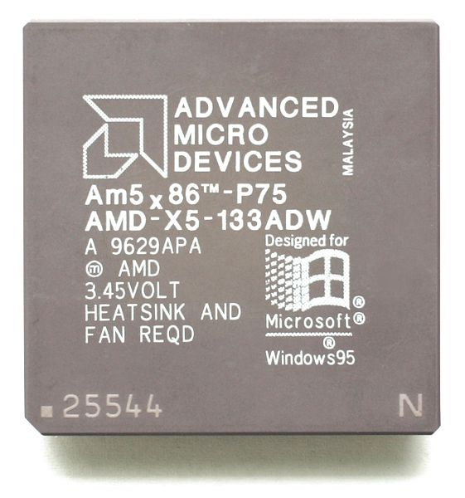
My ancient PC: IBM PS/1 Consultant 2133 19C (built in 1993)
AMD 5X86 486-clone 133mhz
Fastest 486 clones ever made
Similar performance to Pentium 75Mhz
Cirrus Logic VLB CL-GD5424 Graphics 512KiB VRAM
Max 800 x 600
64MB SIMM-72 RAM
48x IDE CD ROM Drive
Gotek 1.44MB floppy emulator
1993 Price: US$2000 Base + US$1000 upgrades
2017 Price: US$5170 = SG$6820

Slide 12
Expansion slots
3x Industry Standard Architecture (ISA) slots
Supports Plug-n-Play (PnP)
2x 32MB SIMM-72 RAM slots

Slide 13
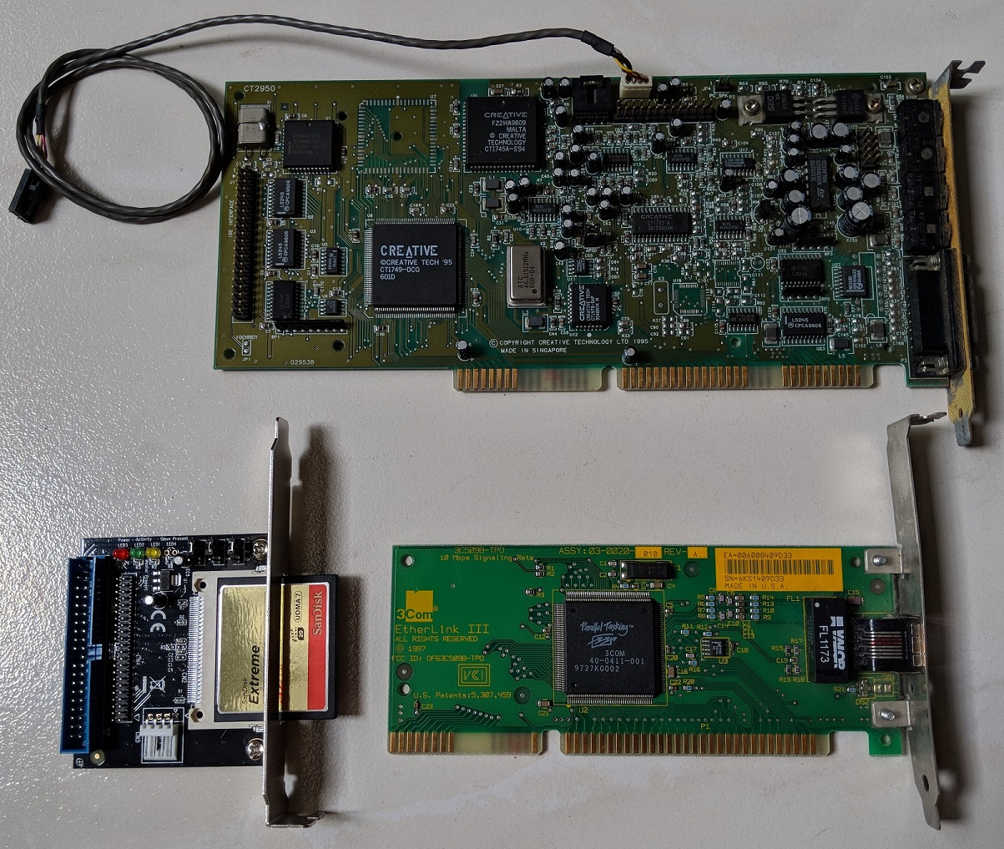
Expansion cards
Sound Blaster 16 (PnP)
10Mbps 3Com Etherlink III 3c509B
CompactFlash-IDE (CF-IDE)
32GB CF card

Slide 14
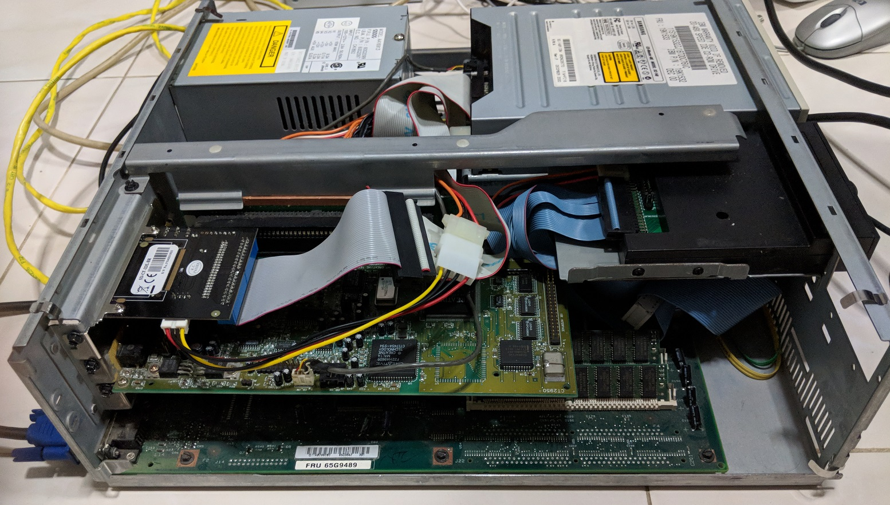
Expansion cards loaded

Slide 15
Demo
uname –a
ifconfig
ping
alsamixer
mocp
nginx
SSH
Git
Python
Go

Slide 16
How was this accomplished?

Slide 17
Use typical Linux distributions?
Ubuntu
Linux Mint
Debian
Arch Linux
Open Suse

Slide 18
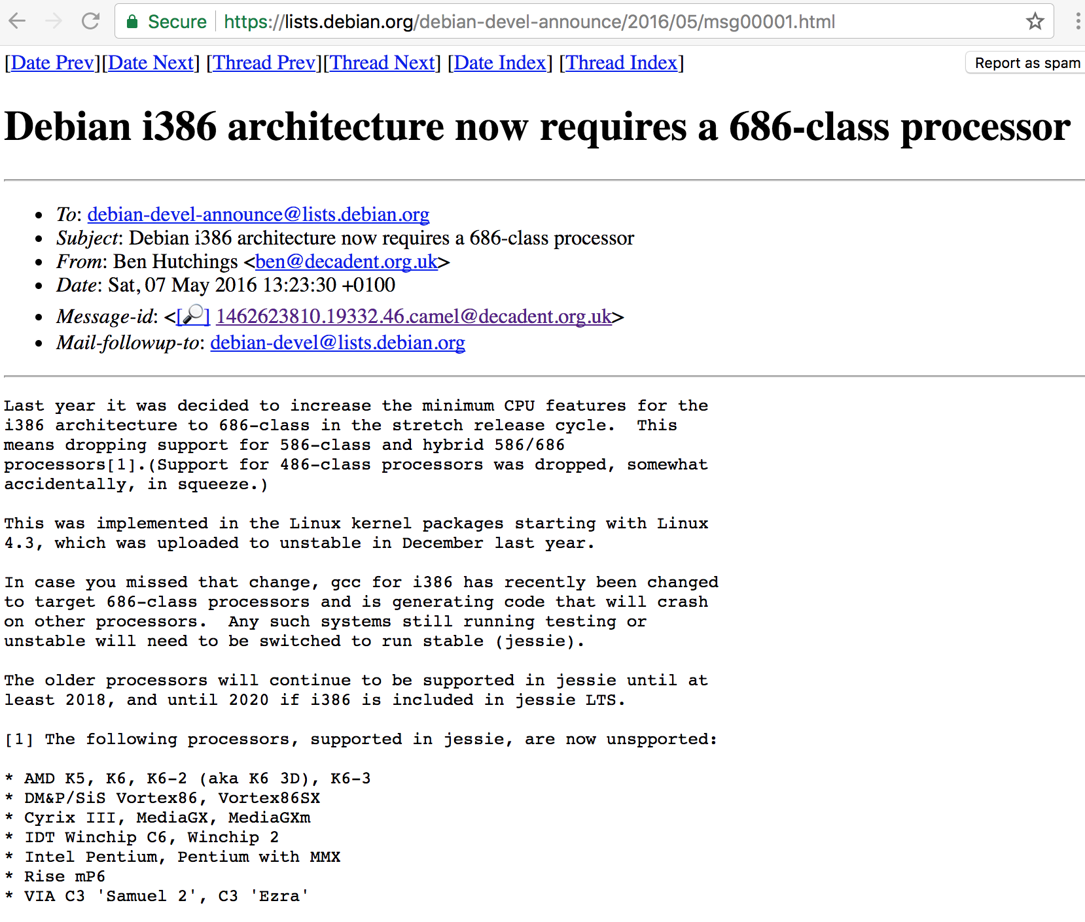
https://lists.debian.org/debian-devel-announce/2016/05/msg00001.html

Slide 19

“Gentoo Linux is a Linux distribution built using the Portage package management system. Unlike a binary software distribution, the source code is compiled locally according to the user’s preferences and is often optimized for the specific type of computer.”
From https://en.wikipedia.org/wiki/Gentoo_Linux

Slide 20
Key steps
Prepare compilation laptop
Partition Disks
Set compilation parameters
Configure Linux Kernel
Compile kernel and other programs
Bootloader
Move CF card to ancient PC and hope it works!

Slide 21
Step 1: Prepare compilation laptop
Intel Core i7-3520M (3.50 GHz, 4MB L3, 1333MHz FSB)
Intel HD Graphics 4000
16GB DDR3 – 1600MHz
Gigabit Ethernet
Ultrabay DVD-RW
USB-CF adapter

Slide 22
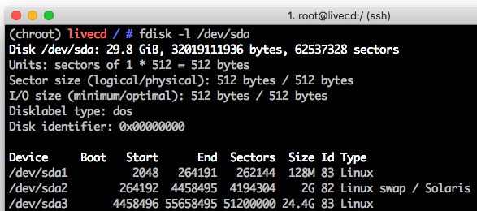
Step 2: Disk partitioning
Boot: 128MiB
Must be within 504MiB BIOS limit
Swap: 2GiB
Root: 24.4GiB

Slide 23
Step 3: Set GCC Compilation parameters
/etc/portage/make.conf
CFLAGS="-O2 -march=i486 -pipe"
CHOST="i486-pc-linux-gnu"

Slide 24
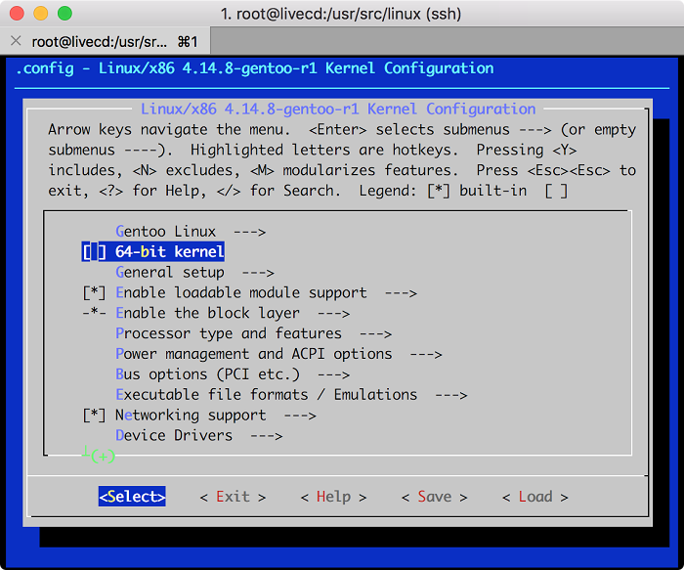
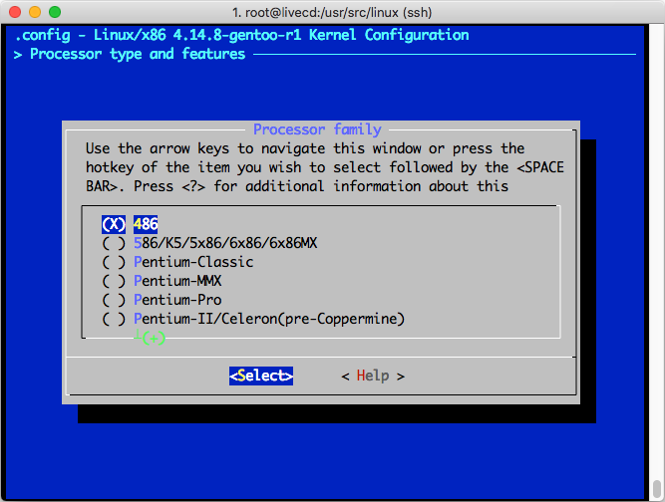
Step 4: Configure Linux kernel
Disable 64-bit kernel
Set lowest supported CPU to 486

Slide 25
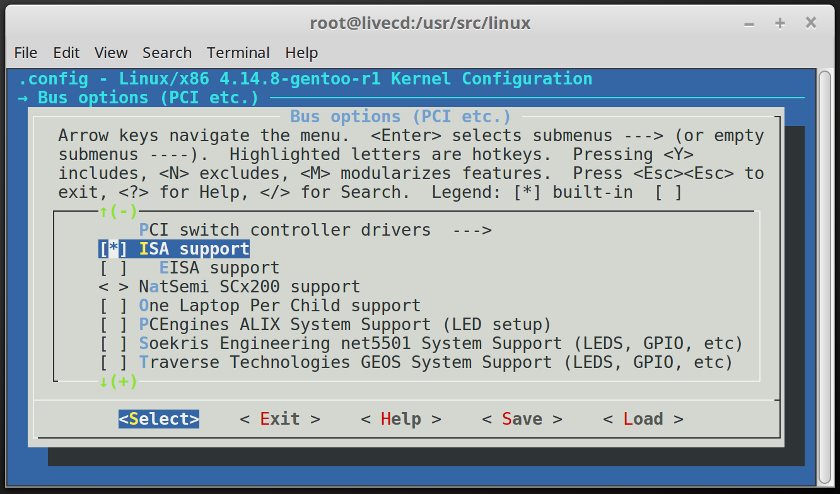
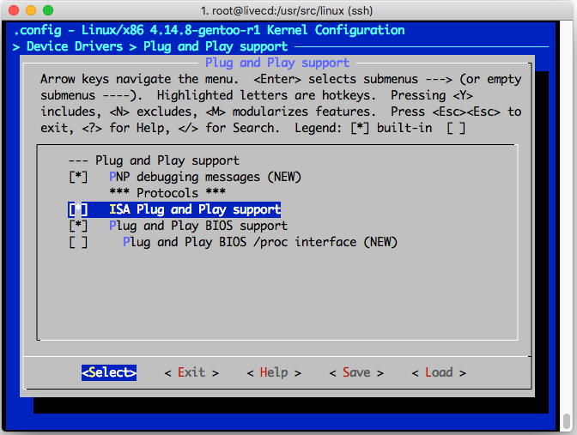
Step 4: Configure Linux kernel
Enable ISA
Enable ISA Plug and Play

Slide 26
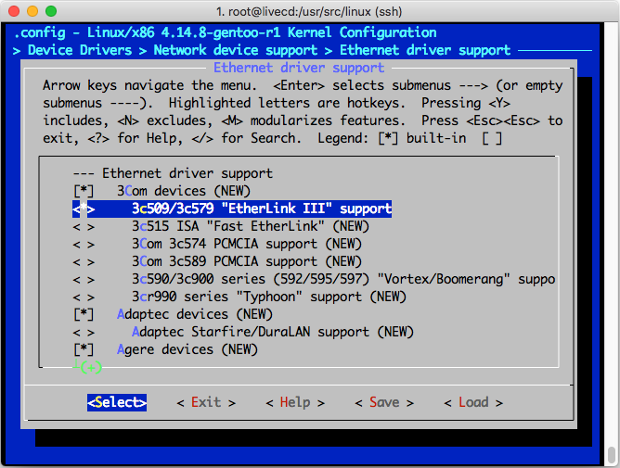
Step 4: Configure Linux kernel
Add 3Com 3c509 driver

Slide 27
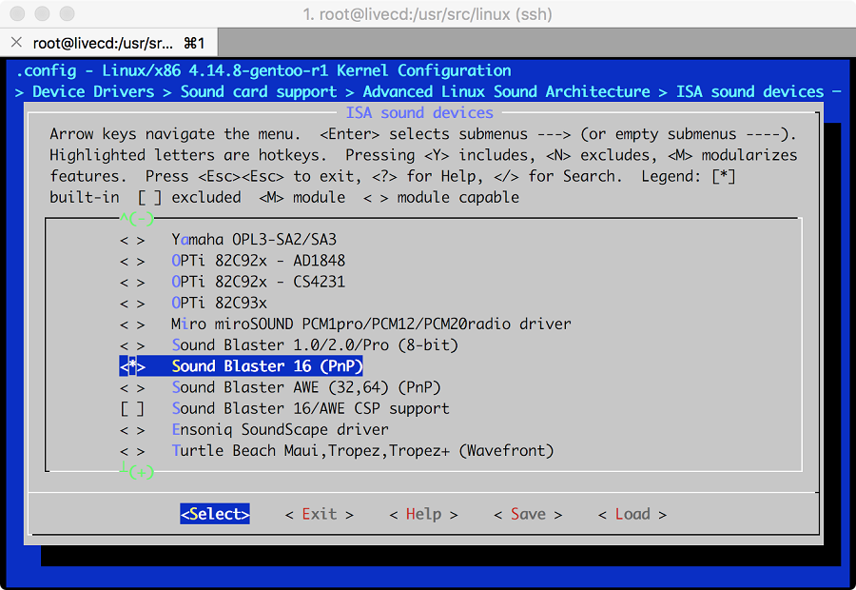
Step 4: Configure Linux kernel
Add Soundblaster 16 driver

Slide 28
Step 6: Compile kernel and other programs

Slide 29
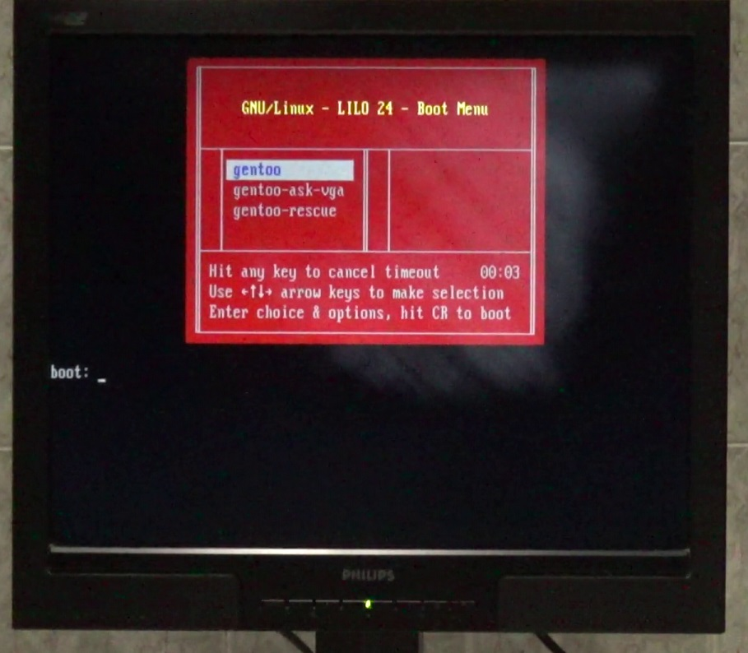
Step 6: Install Bootloader
Install LILO
Grub2 causes reboot loop

Slide 30
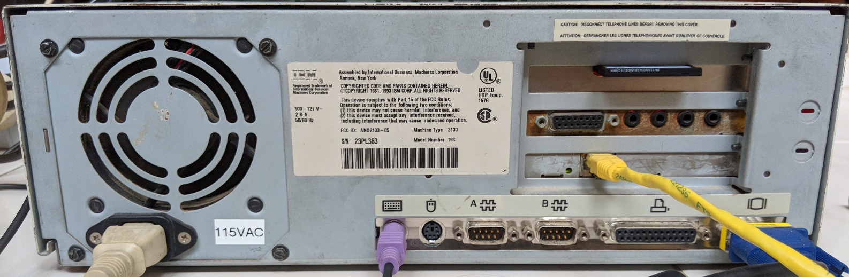
Move CF card to ancient PC and pray!

Slide 31
Problems

Slide 32
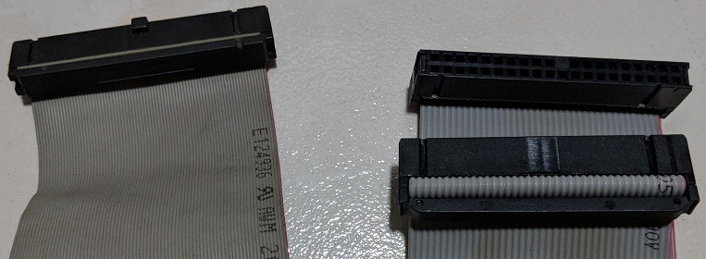
Data corruption with 80-pin PATA cable
80-pin
40-pin
Troubleshooting steps I took
Disconnect CD-ROM drive as primary slave
Replace the CF card
Trying different 80-pin conductor cables
Recompiling the Linux kernel many times with different SATA/PATA options

Slide 33



Tough Gentoo installation procedure
Install all required packages manually
Compile packages from source
Configure all config files
Easy
Difficult

Slide 34
Long iteration cycle
Configure/Compile
Move CF card to compilation PC
Move CF card to ancient PC
Watch bootup/Test

Slide 35
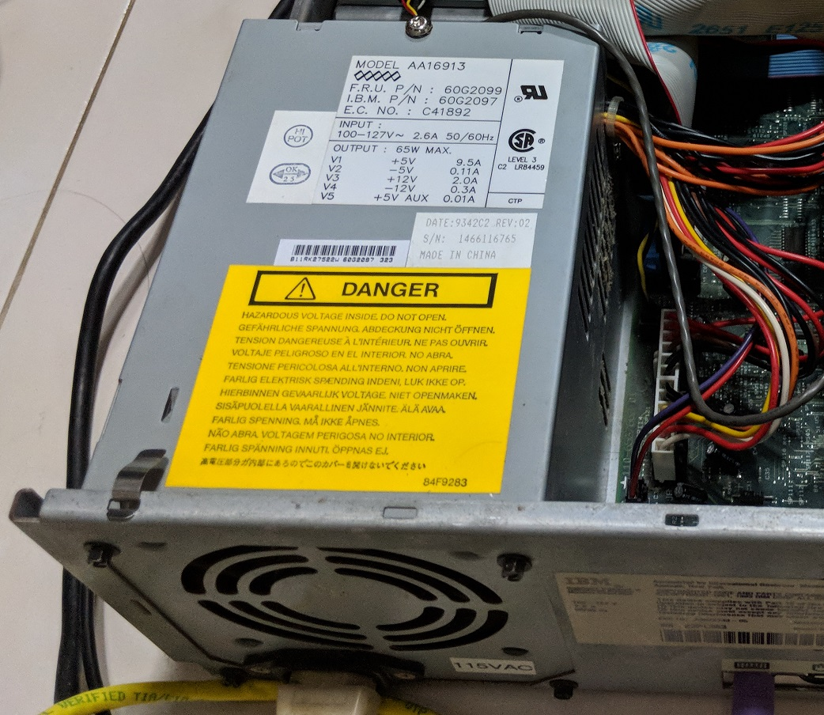
Low Profile Extension (LPX) Power Supply Failed ☹
/

Slide 36
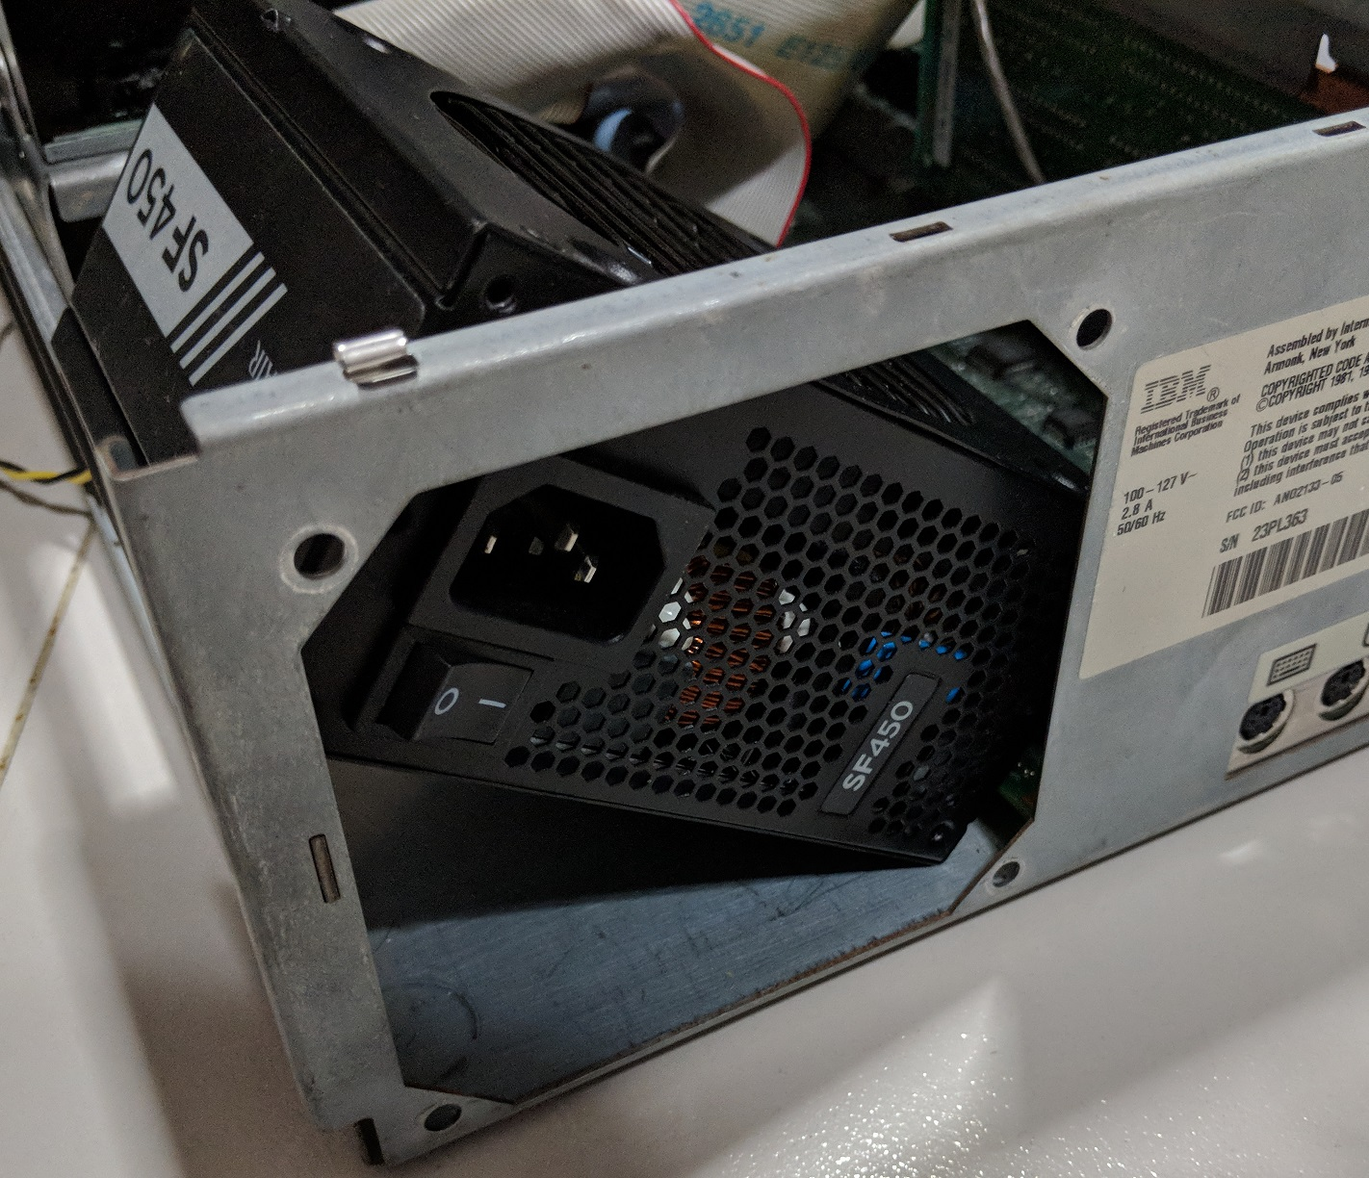
Replace with Small Form Factor (SFF) PSU?

Slide 37
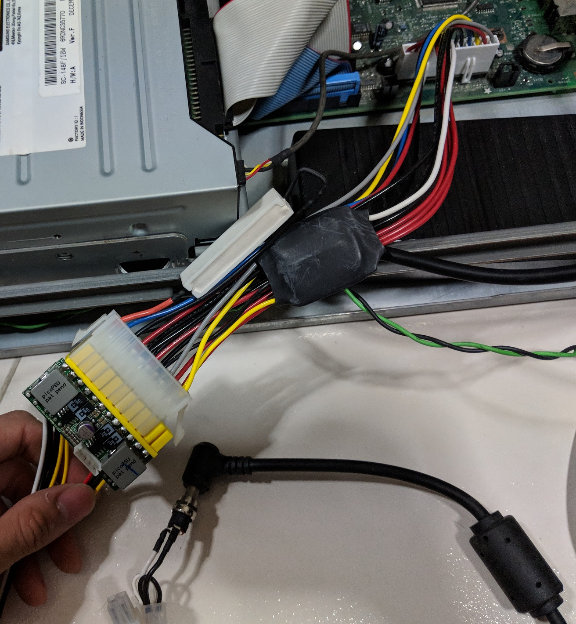
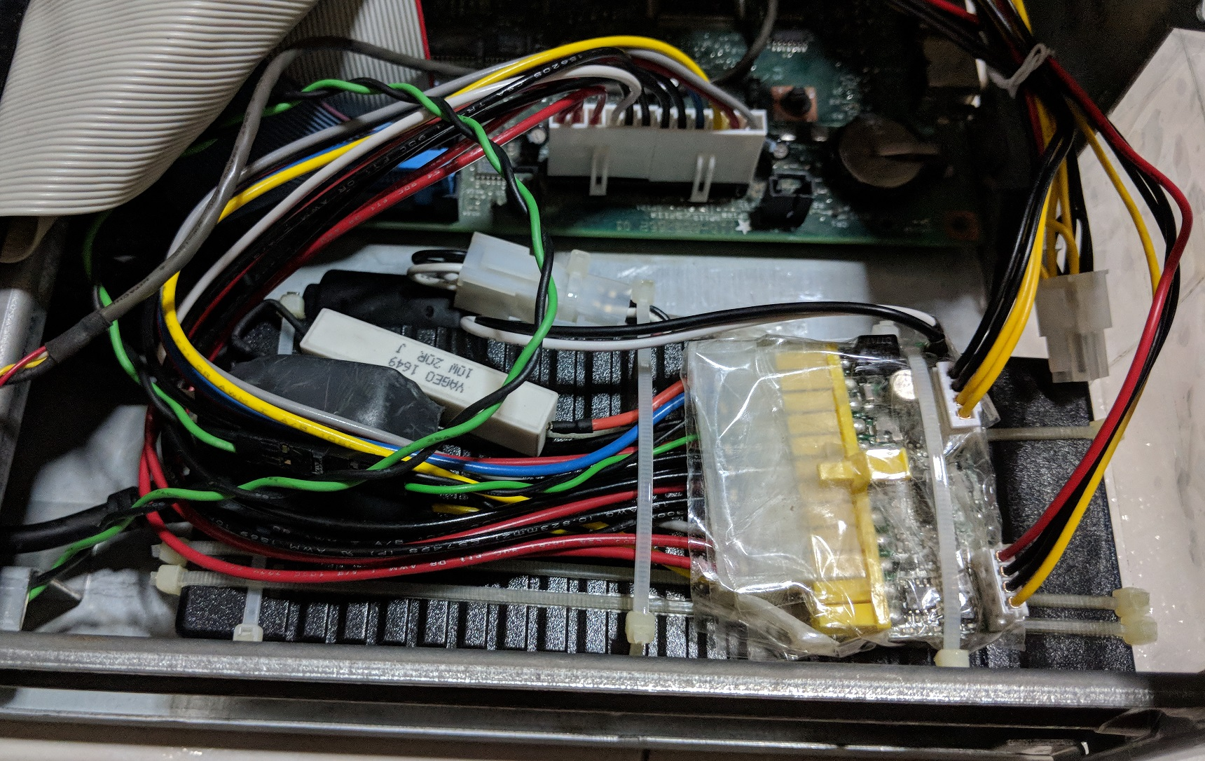
Use 150W PicoPSU + ATX-AT converter

Slide 38
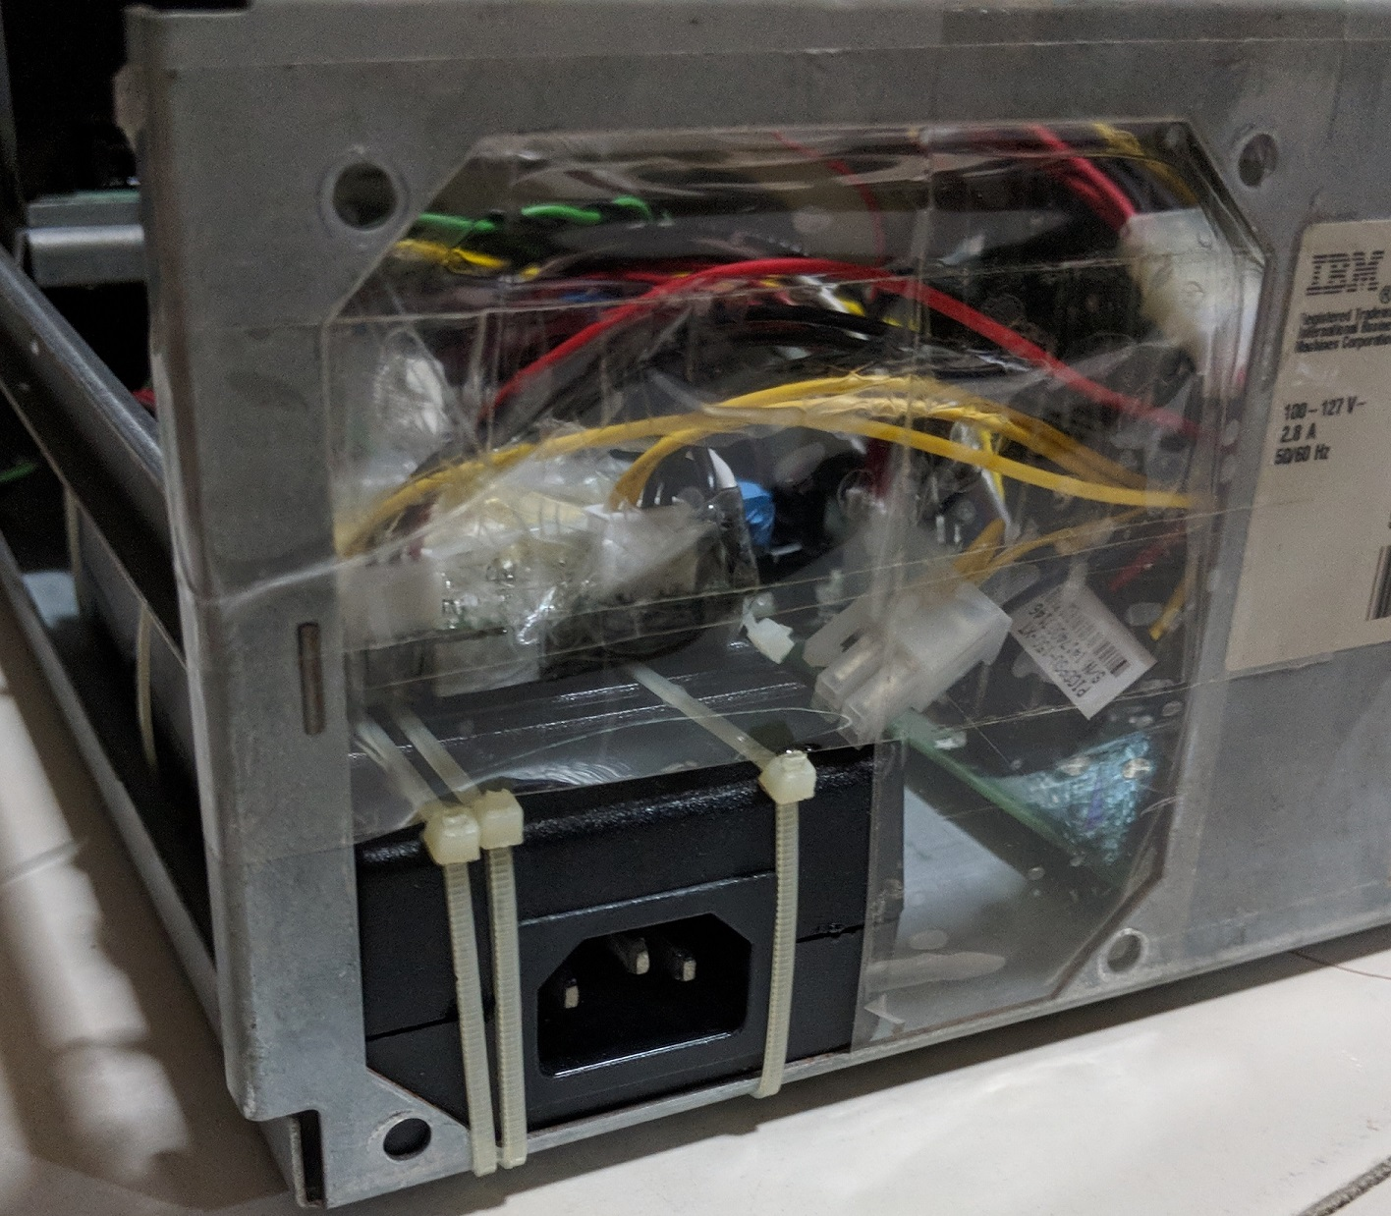

Slide 39


Conclusion
Linux still supports the 486 as claimed!!!
Dog slow:
11 minutes to boot
5.5 minutes to shutdown
Cannot multi-task well with modern software
Meltdown and Spectre proof!

Slide 40
Slashdot and Hackaday
https://linux.slashdot.org/story/18/01/07/228222/can-you-install-linux-on-a-1993-pc
https://hackaday.com/2018/01/07/go-retro-to-build-a-spectre-and-meltdown-proof-x86-desktop/

Slide 41
Questions?
By: Yeo Kheng Meng (yeokm1@gmail.com)
http://yeokhengmeng.com/2018/01/make-the-486-great-again/
https://github.com/yeokm1/gentoo-on-486/

